Slide 1

Transportation & Logistics
Attracting Big Ideas – The Time is Now
Transportation – Big Ideas
Presenter: Peter Wallis, President and CEO,
Van Horne Institute

Slide 2
Transportation & Logistics Industry
Attracting Big Ideas – The Time is Now
Transportation – Big Ideas
Contributors: Paul Godsmark, CAVCOE
John Falcetta, Alberta to Alaska Railway
Randy Hudson, Remote Sensing Solutions

Slide 3
Forces and Sources of Change
Autonomous Vehicles are Disruptive
The auto industry is a century-old eco-system being ogled by outside players hungry for a slice of a $10 trillion mobility market.
Alberta to Alaska Railway
Alberta’s crude oil is a resource desperately trying to reach global markets – here is a solution.
UAV Drones and Technology
“No roads? There is a drone for that”.
“One day a drone might throw you a life preserver”.

Slide 4
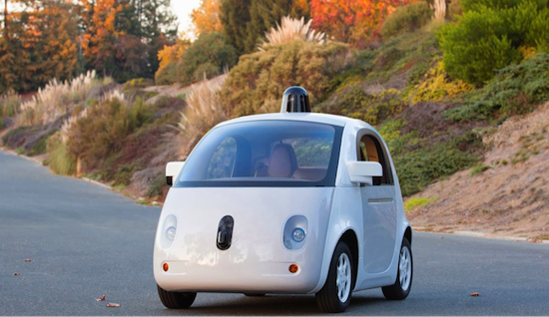
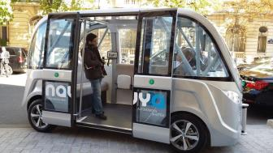
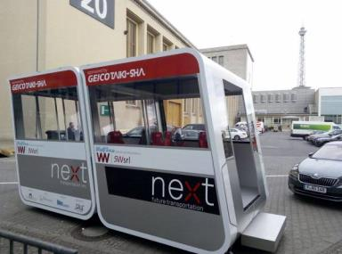
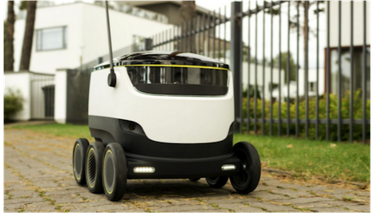
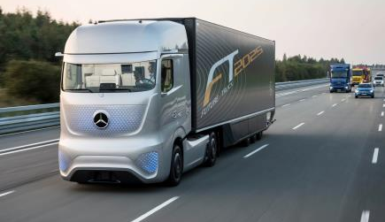

Autonomous Vehicles
Shuttles, Pods, Trucks, Road-Trains, Deliverbots

Slide 5

Huge Impacts
(Canada figures)
Safety – save 80% crashes (3.9% GDP)
Time – save 0.5 Bn hrs
Shared TaaS
Savings $65bn/yr²
²Morgan Stanley est $1.3Tn/yr for US

Slide 6
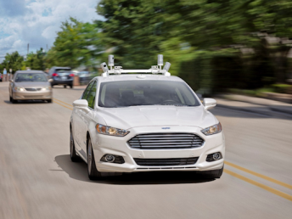
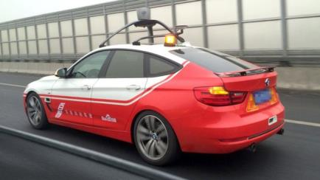
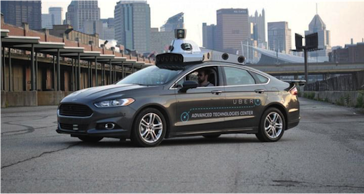
Fully Autonomous - When?
Ford / Baidu – mass produce by 2021
Google – 2017-2020?
Mobileye/Delphi 2019
Taxi trials nuTonomy 2016,
Uber 2016

Slide 7

Why a big deal?
An AV will do work moving people, goods, services
An AV will make money for owner
AV Demand > Supply
Rapid Market Penetration
Disruptive

Slide 8
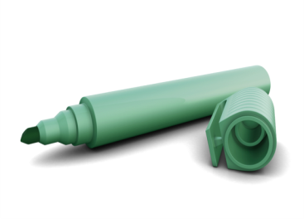

AB, Let’s plan now:
Additive manufacturing
AV app world leaders
AV cyber-security
AV niche products

Slide 9
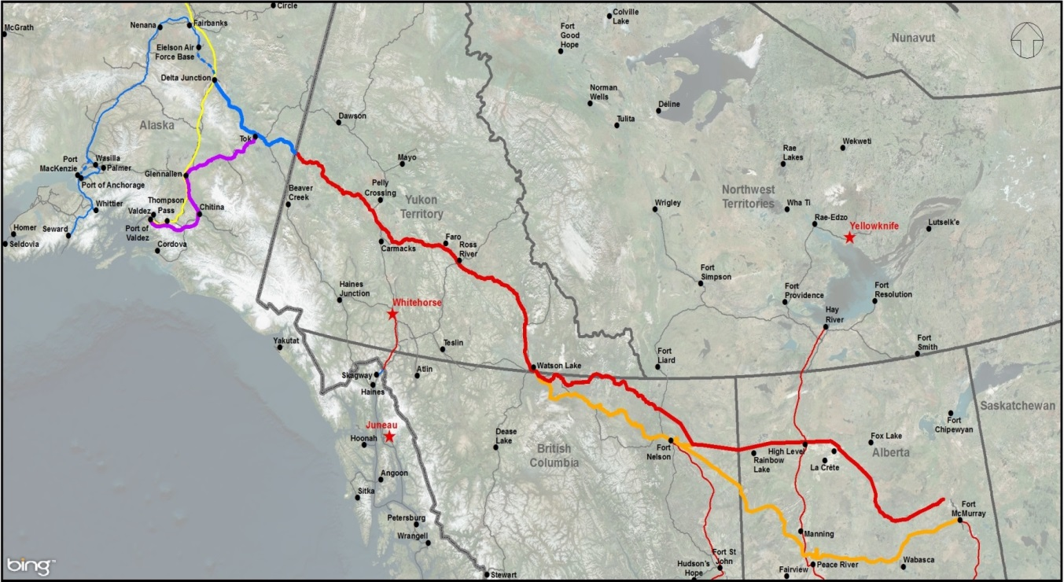
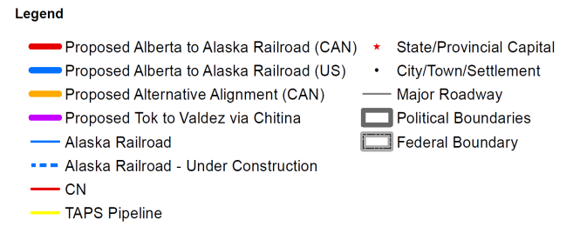
Alberta to Alaska Railway
Design, Permit, Build & Operate a multipurpose railway from Alberta to tidewater
Capacity to move commodities, goods people & data (fibre optics)
Potential to also connect Alaska to lower 48 states
First Nations engaged will be full partners in the project

Slide 10
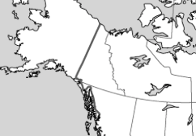
Positive Impacts of the Project: Canadian & US economy improved position to export & import
Additional route into and out of North America
Landlocked commodities can be moved to market
First Nation’s real & substantial ownership of a major enterprise

Slide 11
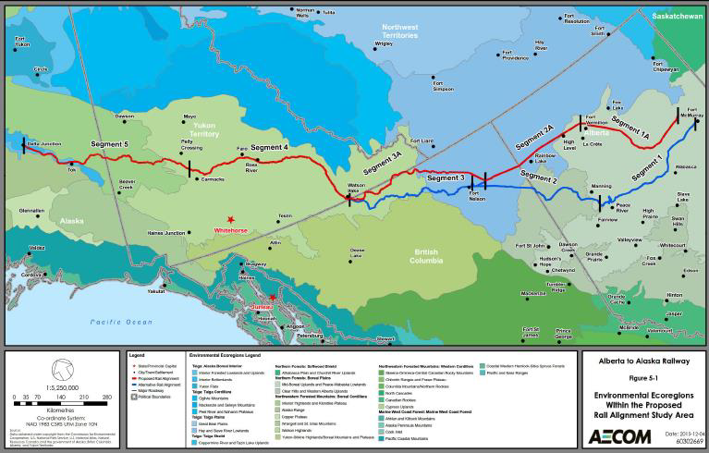
Project Introduction and Description
- Pre-Feasibility Study has been completed
- Bitumen transport on a 2,440 km single track, heavy –haul railway
- Fort McMurray to Delta Junction, alternately to Glennallen, then proceeding to an Alaska tidewater terminal at the Port of Valdez

Slide 12
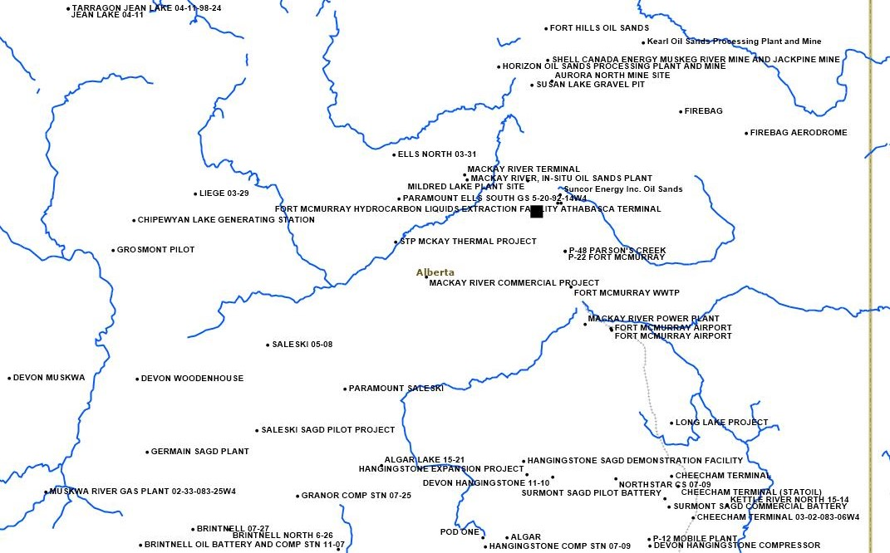
Fort McMurray (redline - mainline, Green line - spurs)
Terminal

Slide 13
A2A: Economic & Financial Highlights
NPV/barrel : $8 - $10 a barrel for the rail portion modelling 1.5 and 1.0 mpbd
NPV tested using high hurdle of 10.2% - increase capital cost of 50% and operating cost increase of 50% under scenarios of 1 mbp.
All in capital cost range $14 billion - $20 billion
Potential $650 billion in extractable minerals within a 50 mile radius of the railbed
$

Slide 14

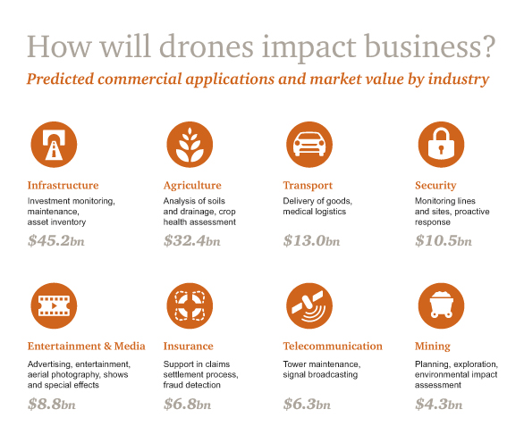
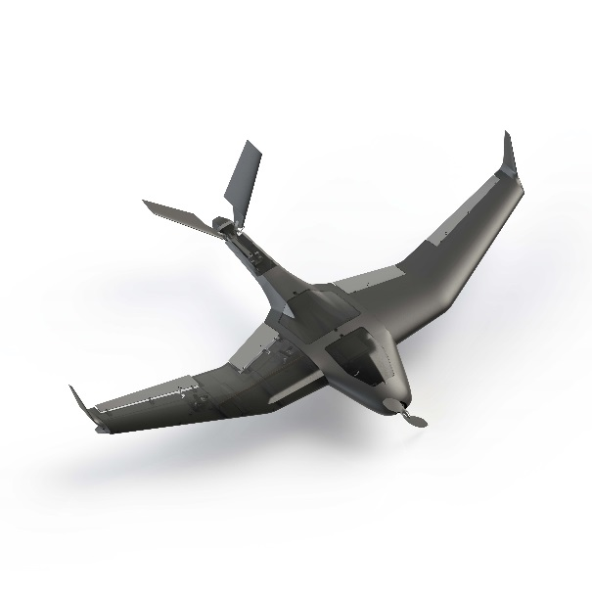

Slide 15
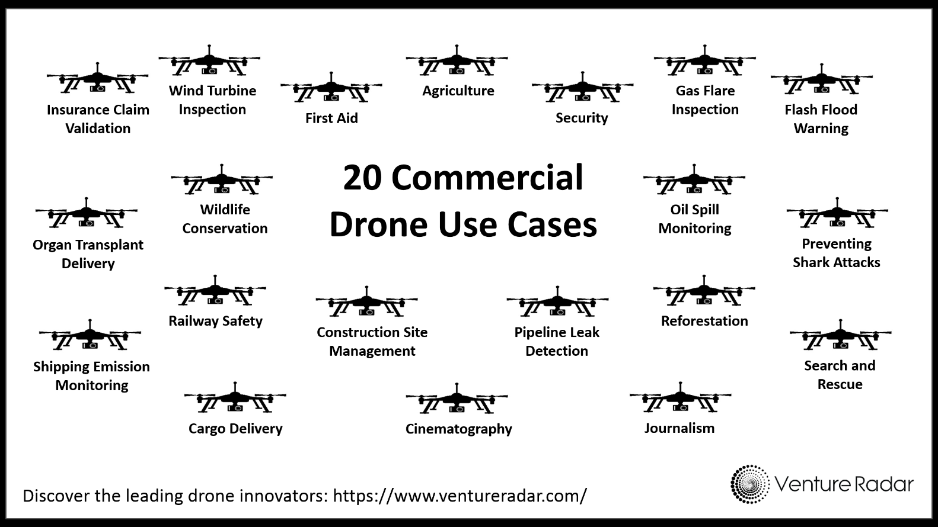
Commercial drones enable rapid and repeatable collection of data from the physical world. This helps enterprises meet compliance requirements, make quicker, better decisions and keep workers safe.

Slide 16
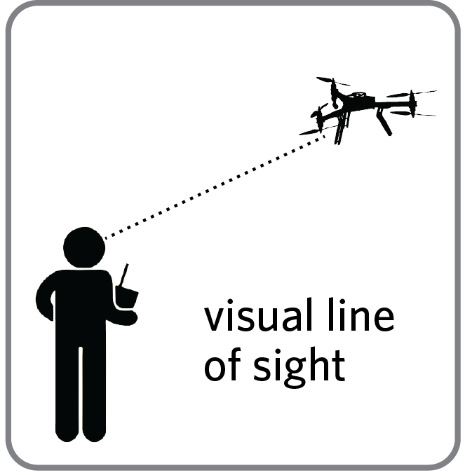

Industry Challenges
Currently Regulations allow for Line of Site Operations- 600M radius. This limits market access for operations in Search and Rescue, Linear Inspection (Rail, Oil, Power) and Environmental Assessment.
Access to Capital is a big challenge for Canadian Tech Start-ups focussing on growth in these markets. Over $450 Million in 2015, primarily in the US and China.

Slide 17
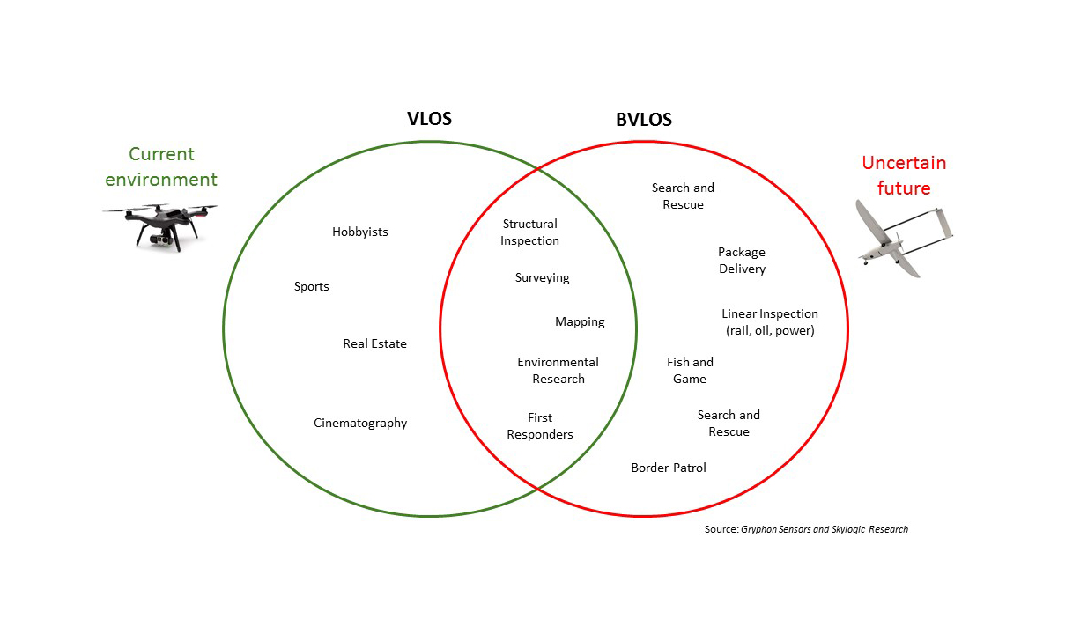
Challenge- Beyond Line Of Site

Slide 18
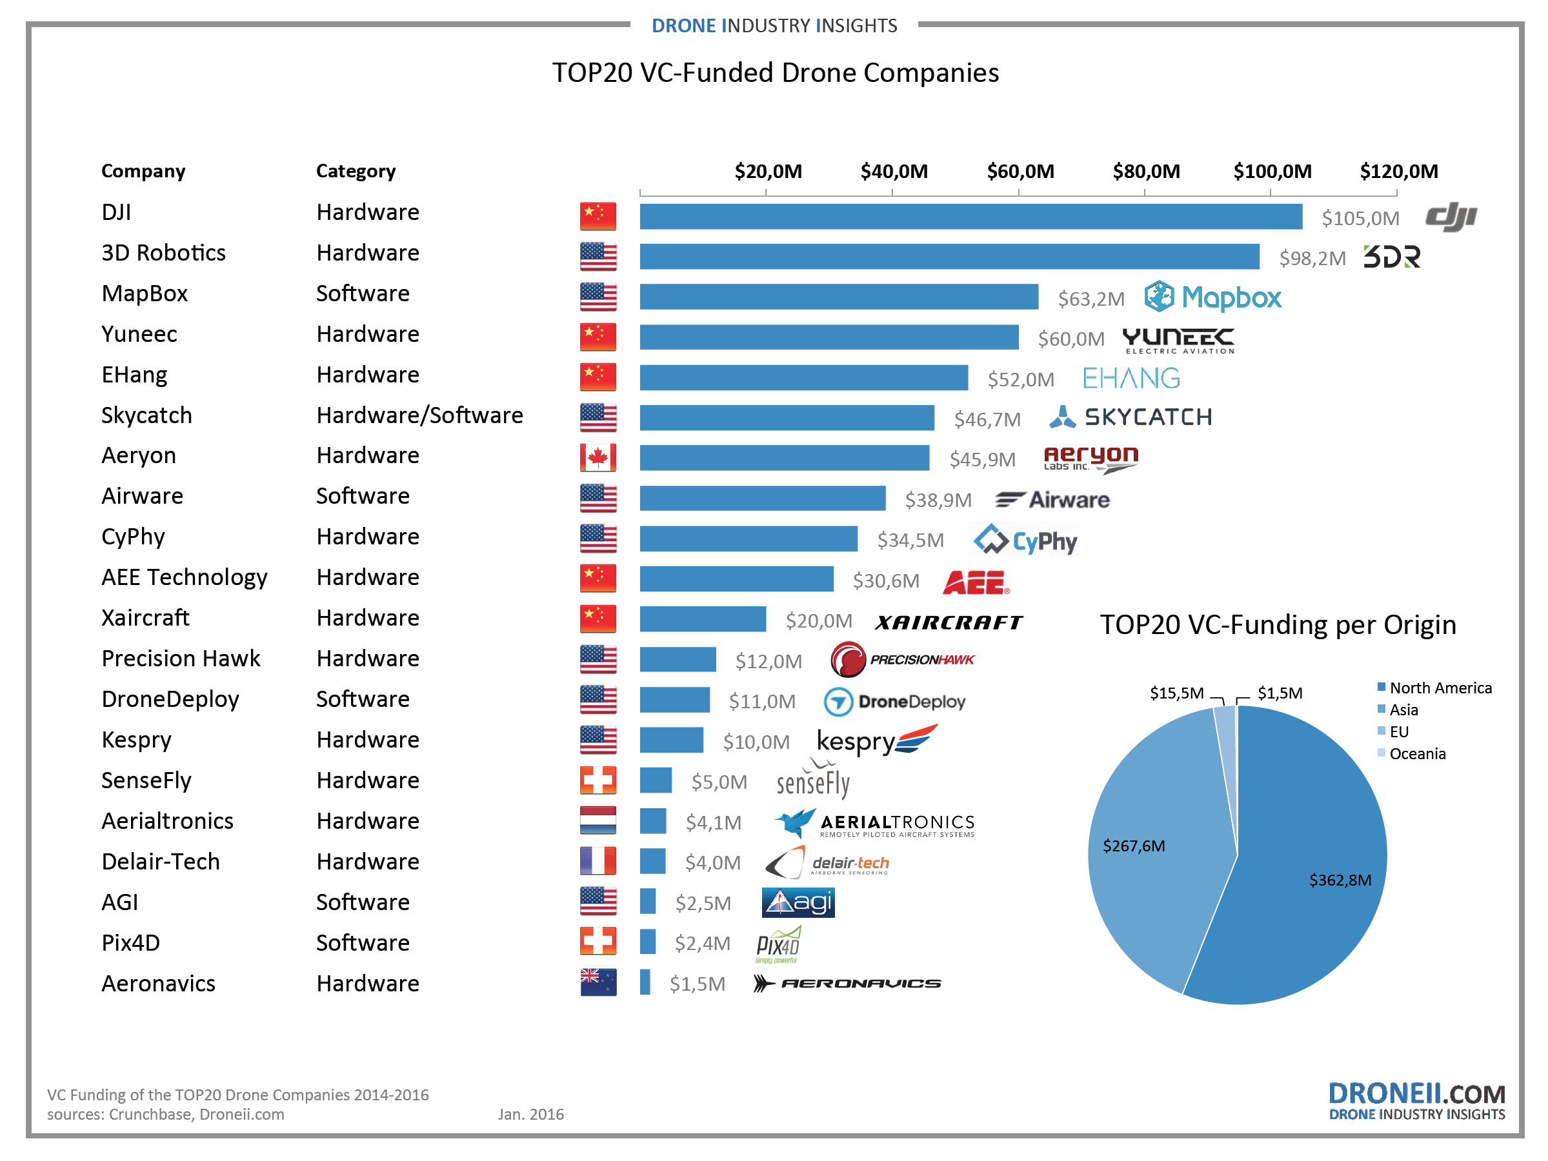
Challenge- Lack of Funding
Of the Top 20 Funded Drone Firms, only one is in Canada!

Slide 19
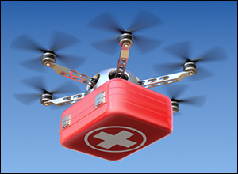
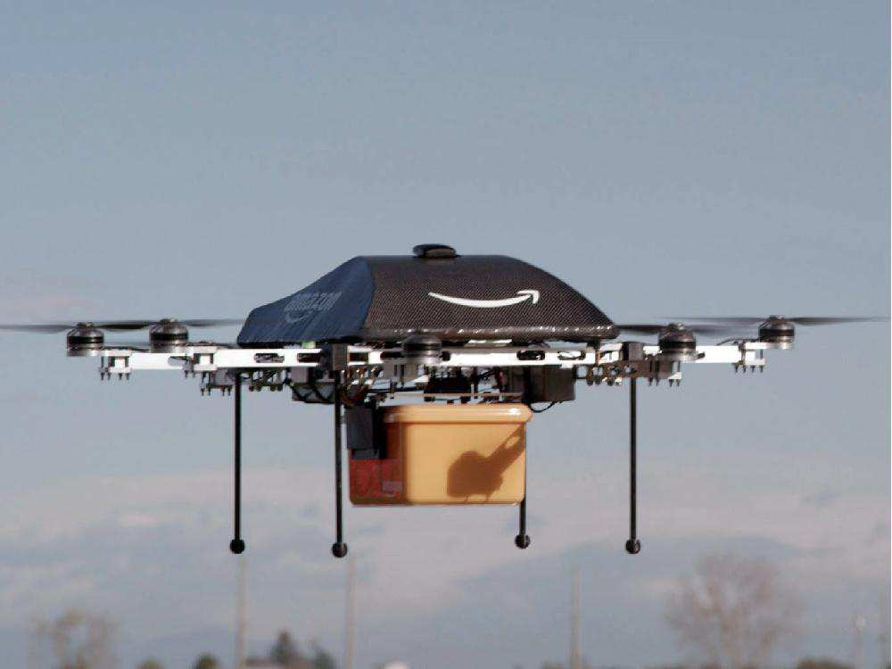
Package Delivery
Realistic in the Near Future!
First Responders or Disaster Response
Remote access delivery
Trans-Continental Cargo Delivery
Not Very Realistic in the Near Future
Amazon Residential Package Delivery? Low probability in the near future. Limits- Regulatory & Battery Efficiency,

Slide 20
Recommendations
Autonomous Vehicles
Government of Alberta license autonomous vehicles for all weather testing through legislation
Government of Alberta commission a panel of experts from across industry academe and government to define a path for the implementation of autonomous vehicles in the Province
Albert to Alaska Railway
Governments ensure that approvals and permitting process is thorough and expeditious
UAV Drones and Technologies
Governments to work with Industry and Transport Canada to ensure safe UAV Operations to allow Beyond Line of Site Operations.
Government to work with industry to allow access to more capital for start ups to grow and compete on the world stage.

