Slide 1



Education & Creativity
Haley Simons

Slide 2
Contributors
Dr. Robert Kelly ▫ University of Calgary
Jean Hendrickson ▫ A+ Schools, Oklahoma, US
Dr. Dennis Cheek ▫ National Creativity Network
Dr. Stephen Murgatroyd ▫ CEO Collaborative Media Group
Carrie Fitzsimmons ▫ CEO ArtScience Prize, Boston
Dr. Michael MacDonald ▫ MacEwan University –
Centre for the Arts and Communications

Slide 3
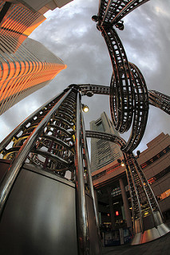

The forces & sources of change

Slide 4
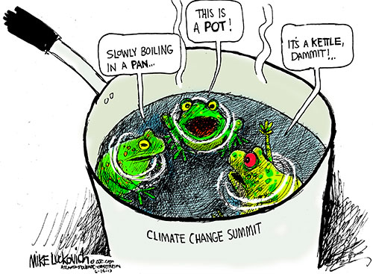

Slide 5


Slide 6

I

Slide 7
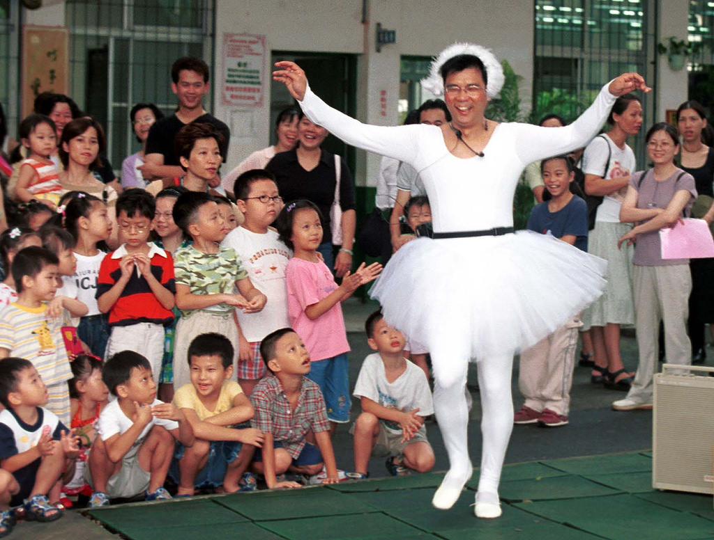

Slide 8


Slide 9
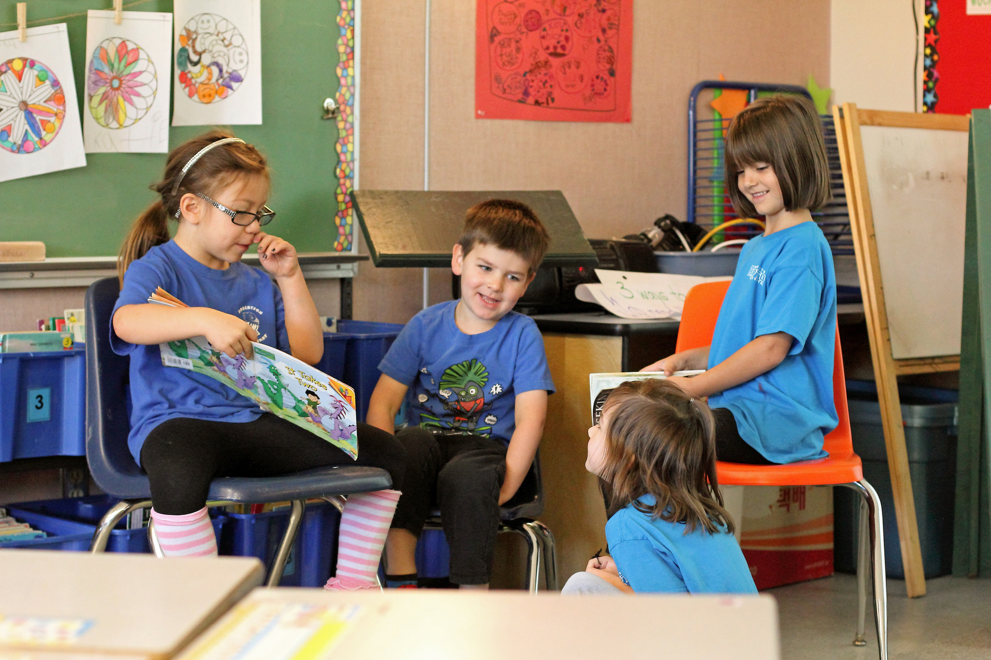

Slide 10
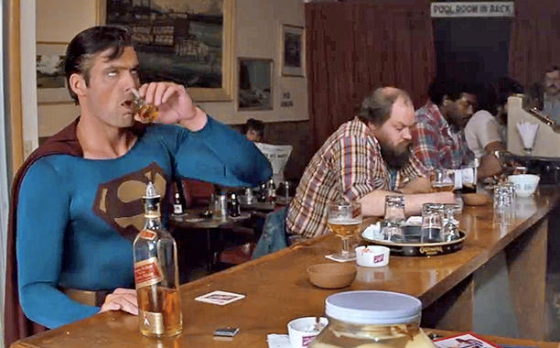

Slide 11
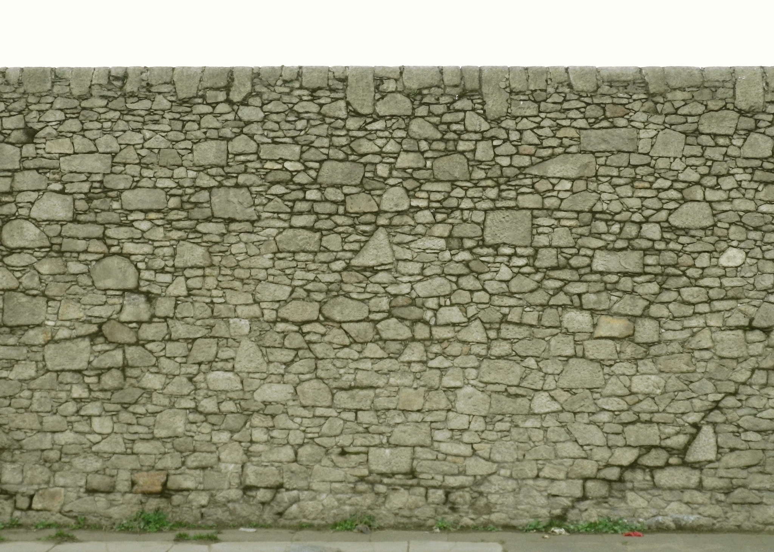

Slide 12
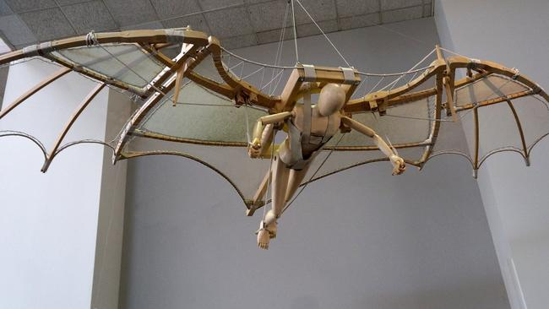

Slide 13
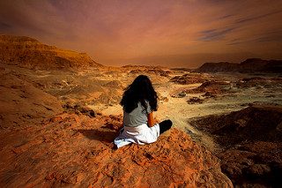

Slide 14
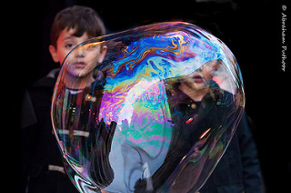

Slide 15
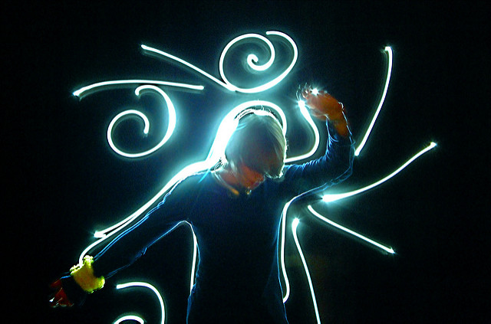

Slide 16


Slide 17
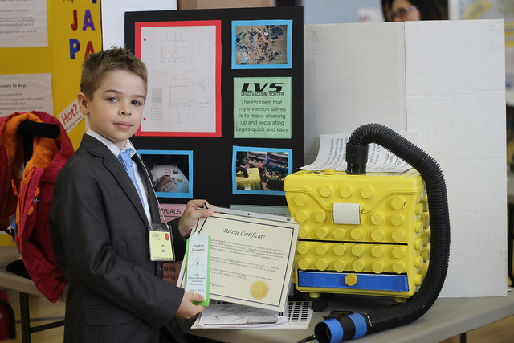

Slide 18


Slide 19
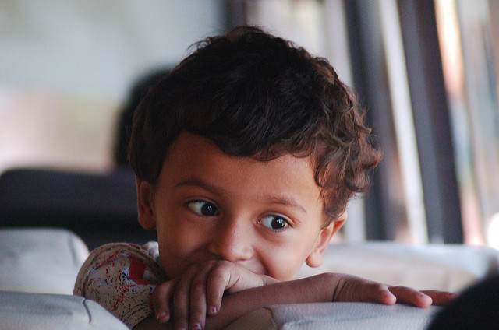

Slide 20
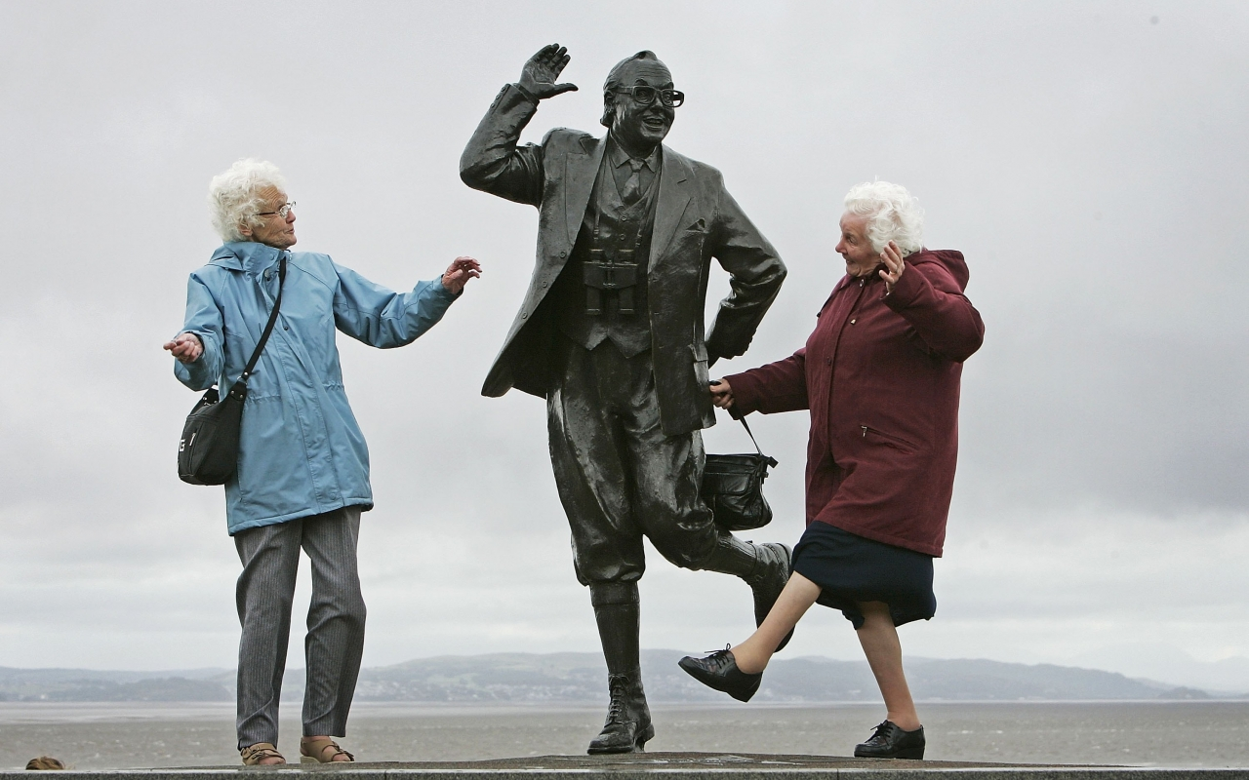
Bridge
Build
Dance
Recommendations
barriers
opportunity
together

