Slide 1

Big ideas to rebuild business models
Notes:
DOUG: Good morning. Today, we are going to talk about disruption in the world of communications and marketing – the collapse of traditional advertising models, the emergence of new competitors and the "end of the world" as we once knew it. And what comes next.

Slide 2

Contributors
Sharon MacLean
President
Doug Firby
President & Publisher
Brian Mulawka
Senior public relations & social media professional
Notes:
DOUG: This presentation is a collaboration of the three people who see on this slide. I'm Doug, this is Sharon and we also thank Brian Mulawka for his input.

Slide 3
Forces of social change
Fragmentation of media
Readers and viewers are leaving while advertisers question value
Ad Investment Shift
Ad spending shifting from traditional media platforms to the internet
Challenges
- Smartphone dilemma, ad blockers
- Reporting resources cut, investigative journalism
- CEOs slow to embrace social enterprise
Notes:
SHARON: There’s been epic disruption in all quadrants when it comes to media…communications…marketing. Traditional ads don’t play on smartphones….Ad blockers are on the rise…new mobile ad models are being introduced every day. And, as we saw in the recent U.S. election, the line has blurred between facts, opinion and even lies.

Slide 4
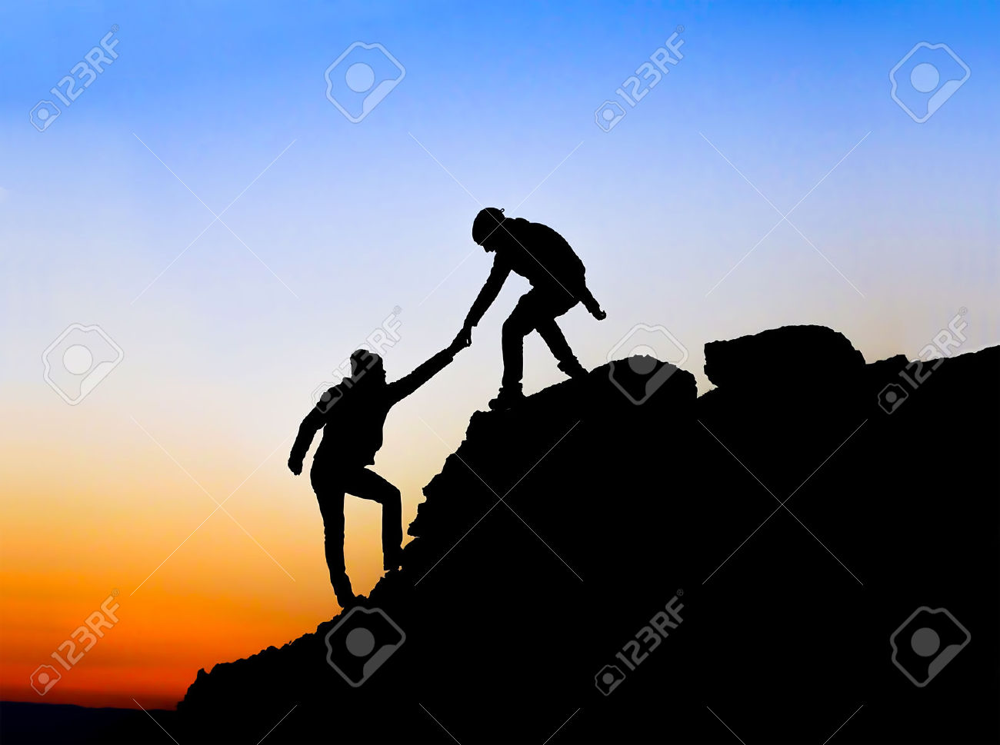
Should government bail out journalism media?
The BBC gave $15-million Cdn to pay for 150 local reporters employed by local news organizations to cover municipal politics and provide their reports, including video and audio, to all local news media websites.
Notes:
DOUG: So journalism in the traditional sense is on life support. And this raises questions about how to revive it. Have a look at this interesting experiment in the U.K. where the BBC funded local reporters at local outlets to provide reports to the broadcaster. It both enhanced journalism and added to accountability.

Slide 5
7 trends in digital news
1
Rise of distributed content via social media sites
2
Women are much more likely to use social media to find news over a website
3
Shared content is big for people and their passions - politics, business, technology, or the environment
4
The rise of news aggregators
5
Algorithms vs editors
6
The rise of mobile – and destination apps
7
Trust matters
Source: Reuters Institute
Notes:
SHARON: People are loving their news aggregators…they like the speed of updates and multiple sources into one place. Yet, they also prefer social networks for interactivity. Should we care about increasing closed mindedness, deepening biases? We just need to look south to see how those hard lines have been drawn!

Slide 6



Responses to the aftershock
Edward Greenspon
President & CEO
T
Federal government
Considering whether it should intervene - support
Google
Subsidizing experimentation and innovation in Europe
Notes:
DOUG: What’s the federal government doing? Two things. First it is giving the CBC $675 million over 5 years to drive our public broadcaster’s shift to a digital platform. But, in classic Canadian style, it has also asked a think tank to study the problem with newspapers. Compare that to Europe, where Google is funding innovation experiments.

Slide 7
10 Big Ideas for Communications and Marketing

Slide 8

Look at your people – some may have trouble adapting
Train everyone on the latest platforms and tools
1. Abandon old paradigms
Kill old business models and outdated marketing techniques
Embrace social enterprise yourself, learn how the platforms work, and how they can drive your company’s success or failure
Determine competencies of your board members, your management team, and your employees
Notes:
DOUG: Change starts with moving away from every bit of conventional wisdom that existed in the past. In its place is embracing social enterprise and all that comes with it.

Slide 9

2. Strategic Alliances
Closer strategic ties between newsroom and corporate brands
Notes:
SHARON: This has been sacred territory until now… ad people should never darken the doors of a news reporter…Yet, here’s what’s possible…media gets quality content they can use by just editing and fact checking, saving them a great deal of time/money. Companies get the reputational benefits and increased credibility that come with being seen as a partner with media.

Slide 10

3. Adjacencies
Stories conceived by advertisers, positioned next to newsroom journalism...BUT…identified distinctly
Notes:
DOUG: One of the new realities is the desire of many organizations to talk directly to their audiences – but not in a deceptive way. Valid, interesting content can run beside editorial content – AS LONG AS it is identified as such. Consider, for example, a paid feature on advances in cancer research, funded by an advertiser. It's interesting, value-added content that a journalist might not be planning to write about in the near future. Of course, this all hinges on keeping the content fact-based and free from biases that benefit the advertiser. If those biases appear, it will hurt both the advertiser AND the media outlet.

Slide 11

4. Multi-platform Repurposing
Tell the story many tines using the full pallet of media
~Vlog Squad by Time Inc. UK
Notes:
SHARON: Re-purposed content saves advertisers lots of money…effective and efficient. Content for this vlog example on YouTube includes tips and advice for the aspiring vlogger. The issue looks at Zoella’s style and comes bagged with a booklet containing a colouring magazine, quizzes, and a poster.

Slide 12

5. Use Google to innovate
Scope Google for ideas on what has worked in Europe. Consider those models to gain efficiencies and grow revenue
Notes:
SHARON: Doug mentioned Google. One of the world’s biggest news aggregators is investing $664 million over 3 years in Europe for innovative projects in digital journalism. The Digital News Initiative (DNI) is a collaboration between Google and news publishers in Europe to support high quality journalism and encourage a more sustainable news ecosystem through technology and innovation.

Slide 13

Sample: Spectrm, Germany
Instant Messengers Distribute Journalistic Content
Traditional media giants are planting their flat in Digital Media
The German start-up Spectrm built an artificial intelligence engine to help publishers communicate directly with readers--and distribute content--on a 1:1 basis through instant messaging apps
Notes:
DOUG: Consumers demand new ways to have content delivered. This experiment in Germany – in which content is CUSTOM DELIVERED via IM to each consumer on a one-to-one basis, tailored to their wants – is enabled by the technology we have today.

Slide 14

Sample: eldiario.es,Spain
Advertising makes up 60% of the site’s revenue stream, but another significant portion — around 40% — now comes from socios, their community
18,000 paying members, and its eye on the next several million
socios primarily pay to support the mission of independent journalism
Notes:
SHARON: Here's an interesting experiment in Spain, in which communities – called socios – contribute to support independent journalism. This revenue stream supplements advertising revenue, which still forms the majority of income.

Slide 15

6. Put journalism first
Reinvest in quality journalism. This may seem counter-intuitive because it adds to costs, but quality journalism is at the core
Discover what your audiences are willing to pay for
from the freemium level to mastermind groups with access to editorial teams. Readers crave compelling content
Notes:
DOUG: If you look at what is going wrong in Canadian newspapers, and in particular the Postmedia/Sun chain, it is the decision to try to cost-cut their way to survival. As revenues drop, these papers have rapidly cut content – which means that consumers are being asked to patronize a product that keeps getting worse. We KNOW that won't work.

Slide 16

7. Streamline processes
Rethink processes from beginning to end
Focus outlets on high-value tasks, eliminate low-value work that can eat up time and reduce multi-tasking, which can undermine the goal of excellence
Notes:
DOUG: So, if good content is an absolute condition for success, how do you cut costs? You have to start by re-engineering the way content is gathered, filtered and delivered. It is essentially a massive retooling project, in which media look at every task they do and find more efficient ways of achieving the end goal.

Slide 17

8. Pool resources
The people who “get this” will thrive and tools will help them get there
The Age of Collaboration is based on the “co-op” model. Third parties can do low-value work efficiently and at competitive prices. “Don’t buy a combine, share it”
Notes:
DOUG: It is shocking how small business, not-for-profits, and the media – even with all the consolidation – have not learned from solopreneurs in the digital age. They have not learned to pool resources. Independent community newspapers would do much better if they found a way to share resources.

Slide 18

9. Market to engage subscribers
Use marketing strategies to build relationships that align with readers, audience members, and potential subscribers
Notes:
SHARON: Business used to rely on media outlets to reach their audiences. Companies now should be thinking of how they can create their own audience…by developing relationships with followers who know and trust them.

Slide 19

10. Build social enterprise
Encourage AB CEOs and C-suite to commit to social enterprise
Promote an open and inclusive internal culture and lead by example. Train and trust employees, ensure management understands the technical systems, and build a community of fans to share stories. Regularly monitor content distribution and engagement
Notes:
SHARON: Our collaborator Brian and Servus Credit Union are doing some of this and already see great potential. Your employees are enthusiastic about your company so make it easier for them to tell that story while minimizing risk. Train and trust employees, ensure management understands the technical systems, and build a community of fans to share stories. Regularly monitor content distribution and engagement.

Slide 20

The future of Communications and Marketing
It’s Clear Sailing for Communications and Marketing
The future belongs to the corporation that recognizes its strength is the sum of personal brands belonging to all who work there…to business partners…sponsors…interest groups…and customers.
Notes:
SHARON: We’re inside a different vortex going forward for communications and marketing. No longer are we depending on a single spokesperson’s voice to articulate the company position for Big Business and the Community…but also for small business that contributes to Alberta’s changing economy. It’s a challenging space for old-school communicators…because they’re being asked to give up control…and to widen their circles of influence in real time that engages their wider communities.

