Slide 1
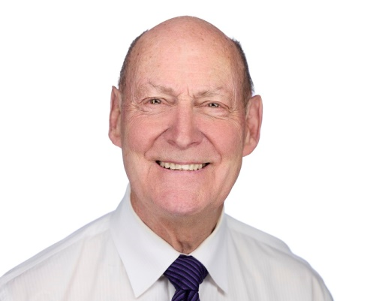

History & Hysteria About ChatGPT
Reshaping the knowledge economy and welcoming the …
Prepared for:
PROBUS Club of Central Edmonton
September 19th, 2023
Perry Kinkaide
KEInetwork.net

